Slide 1

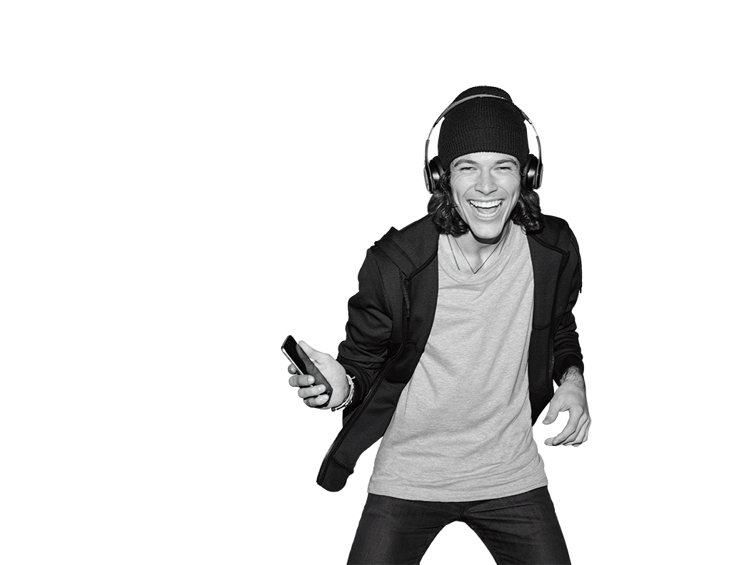


TR# 2017325

Slide 2
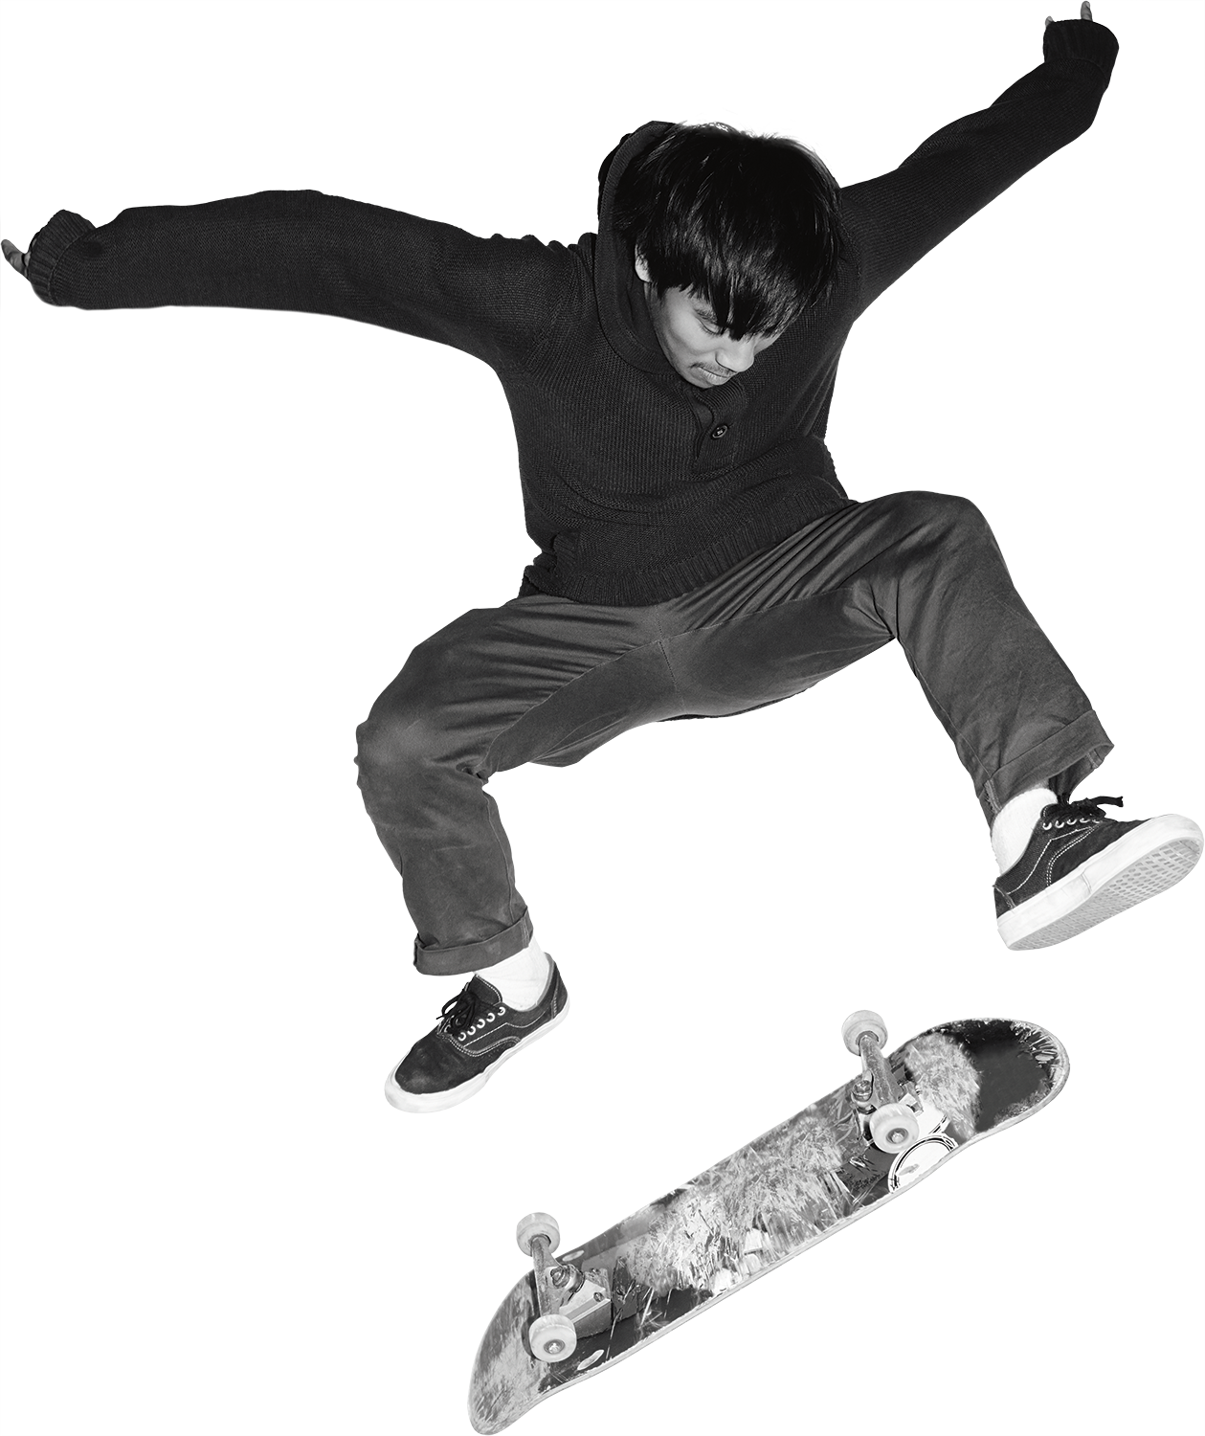

Signature
Moves
2 – Signature Moves
T-Mobile confidential and proprietary information. Not for customer distribution.

Slide 3

INTRO
SIGNATURE MOVES:
Eliminate pain points.
Make us stand out as the Un-carrier.
Are a big deal in the Interaction Model.
Answer “Why T-Mobile?”
Showcase our network.
Are a reason to PARTY!
Let’s check ‘em out together!
3 – Signature Moves
T-Mobile confidential and proprietary information. Not for customer distribution.

Slide 4

DO IT YOURSELF
1 HR 15 MIN
RESEARCH
Research Signature Moves (422131)
Read all overviews
Dig into our current moves
Be an expert on the latest
COMPLETE
Complete the following web-based training in Un-carrier Academy:
Team of Experts
WRITE
For each Signature Move, write:
One feature
One benefit
Any questions
4 – Signature Moves
T-Mobile confidential and proprietary information. Not for customer distribution.

Slide 5

The Download
Let’s go down the list (features, benefits, and questions).
Which Signature Move is your favorite? Why?
Which one was the most confusing?
Which ones might customers NOT know about?
Which tool from yesterday weaves Signature Moves into the conversation?
5 – Signature Moves
T-Mobile confidential and proprietary information. Not for customer distribution.

Slide 6
BRING IT TOGETHER
60 MIN
Split into small groups for 15 minutes.
Choose a video customer (437605).
Pick a Signature Move and identify the benefit.
Practice striking up a conversation.
Tie the benefit to the customer’s situation.
Make sure they feel heard and want to hear more.
Act natural.
Choose a teammate to share with the group.
6 – Signature Moves
T-Mobile confidential and proprietary information. Not for customer distribution.

Slide 7

The Download
How’d we use the Interaction Model here?
What triggered you to choose the Signature Move you did?
Was it hard to not talk about features?
How can we avoid making a connection that’s not there?
Are you ready to talk about Signature Moves in your home store?
7 – Signature Moves
T-Mobile confidential and proprietary information. Not for customer distribution.

Slide 8

Signature Moves
Look for…Signature Moves.
Which Signature Moves were part of the customer conversation today? What did the conversation sound like?
See it! T-Mobile Connect
Practice using Customer Connect and note all the places where Signature Moves appear.
Ask a Mobile Expert!
Ask a Mobile Expert what their strategy is for working Signature Moves into their customer conversations.
8 – Signature Moves
T-Mobile confidential and proprietary information. Not for customer distribution.

